Slide 1
Contraception
3A3

Slide 2
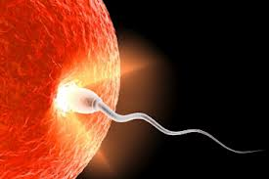
Conception

Slide 4
What is the only 100%
effective method of contraception?

Slide 5
Who is responsible for contraception?

Slide 6
Types of contraception
Barrier
Hormonal
Other

Slide 7
Monday | Tuesday | Wednesday | Thursday | Friday | Saturday | Sunday
Weekly life…..

Slide 8
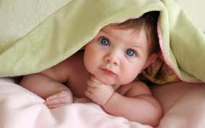
Monday | Tuesday | Wednesday | Thursday | Friday | Saturday | Sunday

Slide 9
Who do you talk to?

